Slide 1
Software Quality Assurance
Dr. Seemab Latif
Lecture No. 2
17th February, 2011

Slide 2
Review of Previous Lecture
Why Software Quality Assurance is important?
Discuss some of the famous software disasters.
What is Software Testing, Quality Assurance and Software Quality Control.
Scope and Content Hierarchy.
Difference between software Testing, Quality Assurance and Software Quality Control.
What is software testing, its role and objectives and software reliability.
Defined and explained defect, fault, error and failure.
Described test cases.
Concept of complete testing and what are the reasons that limit complete testing.

Slide 3
What is Testing
While many definitions have been written, at its core testing is the process of comparing "what is" with "what ought to be."

Slide 4
Formal Definition of Testing
A more formal definition is given in the IEEE Standard 610.12-1990, "IEEE Standard Glossary of Software Engineering Terminology" which defines "testing" as:
"The process of operating a system or component under specified conditions, observing or recording the results, and making an evaluation of some
aspect of the system or component."

Slide 5
Levels of Testing
There are four levels of testing based on four levels of system development:
Unit Testing
Integration Testing
System Testing
Acceptance Testing
Another intermediate level of testing is Regression Testing.

Slide 6
Levels of Testing
Testing is performed at different levels involving the complete system or parts of it throughout the life cycle of a software product.
A software system goes through four stages of testing before it is actually deployed. These four stages are known as unit, integration, system, and acceptance level testing.
The first three levels of testing are performed by a number of different stakeholders in the development organization, where as acceptance testing is performed by the customers.

Slide 7
Verification and Validation
Verification
process to ensure that the design outputs of particular phase of the SDLC meet all specified requirements for that phase.
also known as In-Process Testing.
typically involves reviews and meetings to evaluate documents, plans, code, requirements and specifications.
determines consistency, correctness and completeness of a program at each stage.
Verification is the checking or testing of items, including software, for conformance and consistency with an associated specification.
Verification: Are we building the product right?
Validation
is the process to test whether the product meets the customer requirements in the intended environment.
also known as Exit or End Process Testing.
involves actual testing and takes place after the verification are complete.
determines the correctness of final build with respect to its requirements.
Validation is the process of checking that what has been specified is what the user actually wanted.
Validation: Are we building the right product?

Slide 8
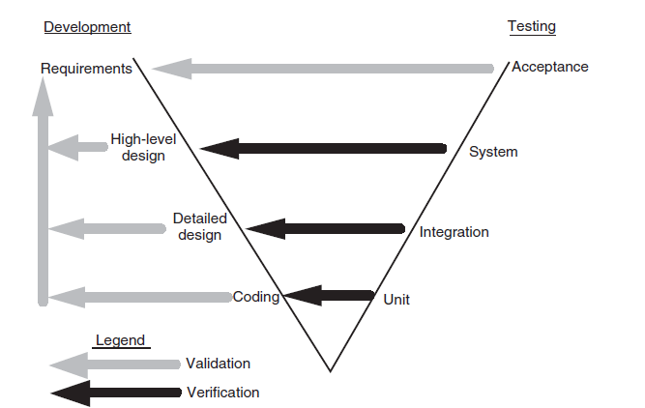
The ‘V’ Model
The four stages of testing have been illustrated in the form of classical ‘V’ model.
Development and Testing Phases in the ‘V’ Model

Slide 9
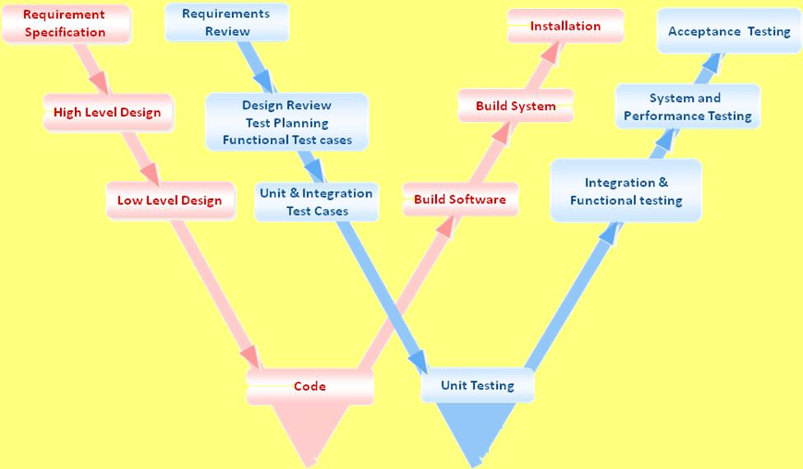
The ‘W’ Model
Extension of V model is W Model, which is also known as verification and validation (VnV) model.

Slide 10
Unit Testing
In unit testing, programmers test individual program units, such as procedures, functions, methods, or classes, in isolation.
After ensuring that individual units work to a satisfactory extent, modules are assembled to construct larger subsystems by following integration testing techniques.

Slide 11
Integration Testing
Integration testing is jointly performed by software developers and integration test engineers.
The objective of integration testing is to construct a reasonably stable system that can withstand the rigor of system-level testing.

Slide 12
System Testing
System-level testing includes a wide spectrum of testing, such as functionality testing, security testing, robustness testing, load testing, stability testing, stress testing, performance testing, and reliability testing.
System testing is a critical phase in a software development process because of the need to meet a tight schedule close to delivery date, to discover most of the faults, and to verify that fixes are working and have not resulted in new faults.
System testing comprises a number of distinct activities:
creating a test plan,
Designing a test suite,
preparing test environments,
executing the tests by following a clear strategy, and
monitoring the process of test execution.

Slide 13
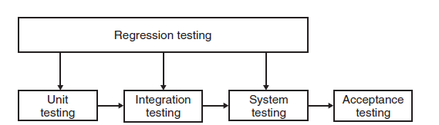
Regression Testing
Regression testing is another level of testing that is performed throughout the life cycle of a system. Regression testing is performed whenever a component of the system is modified.
The key idea in regression testing is to ascertain that the modification has not introduced any new faults in the portion that was not subject to modification.
Regression testing is not a distinct level of testing. Rather, it is considered as a sub-phase of unit, integration, and system-level testing.

Slide 14
Acceptance Testing
After the completion of system-level testing, the product is delivered to the customer. The customer performs their own series of tests, commonly known as acceptance testing.
The objective of acceptance testing is to measure the quality of the product, rather than searching for the defects, which is objective of system testing.
A key notion in acceptance testing is the customer’s expectations from the system. By the time of acceptance testing, the customer should have developed their acceptance criteria based on their own expectations from the system.

Slide 15
Kinds of Acceptance Testing
There are two kinds of acceptance testing as explained in the following:
User acceptance testing (UAT): is conducted by the customer to ensure that the system satisfies the contractual acceptance criteria before being signed off as meeting user needs.
Business acceptance testing (BAT): is undertaken within the supplier’s development organization. The idea in having a BAT is to ensure that the system will eventually pass the user acceptance test. It is a rehearsal of UAT at the supplier’s premises.

Slide 16

Types of Testing
Testing is often divided into:
Black Box Testing .
White Box Testing.
Grey Box Testing.

Slide 17
Black Box Testing
Black box testing is a strategy in which testing is based solely on the requirements and specifications.
Black box testing requires no knowledge of the internal paths, structure, or implementation of the software under test.

Slide 18
White Box Testing
White box testing is a strategy in which testing is based on the internal paths, structure, and implementation of the software under test.
White box testing generally requires detailed programming skills.

Slide 19
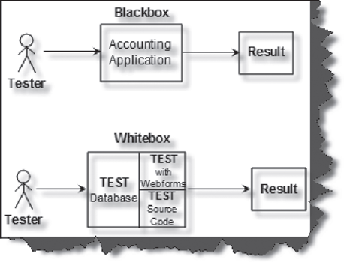
Black Box and White Box Testing in Action
The following figure shows how both types of testers view an accounting application during testing. Black box testers view the basic accounting application. While during white box testing the tester knows the internal structure of the application. In most scenarios white box testing is done by developers as they know the internals of the application. In black box testing we check the overall functionality of the application while in white box testing we do code reviews, view the architecture, remove bad code practices, and do component level testing.
Black box and White box testing in Action

Slide 20
Grey Box Testing
An additional type of testing is called Grey box testing. In this approach we peek into the "box" under test just long enough to understand how it has been implemented. Then we close up the box and use our knowledge to choose more effective black box tests.

Slide 21
Summary
Testing: process of comparing "what is" with "what ought to be."
Levels of Testing:
Unit Testing
Integration Testing
System Testing
Acceptance Testing
Regression Testing
Types of Testing
Black Box Testing
White Box Testing
Grey Box Testing

